Slide 1
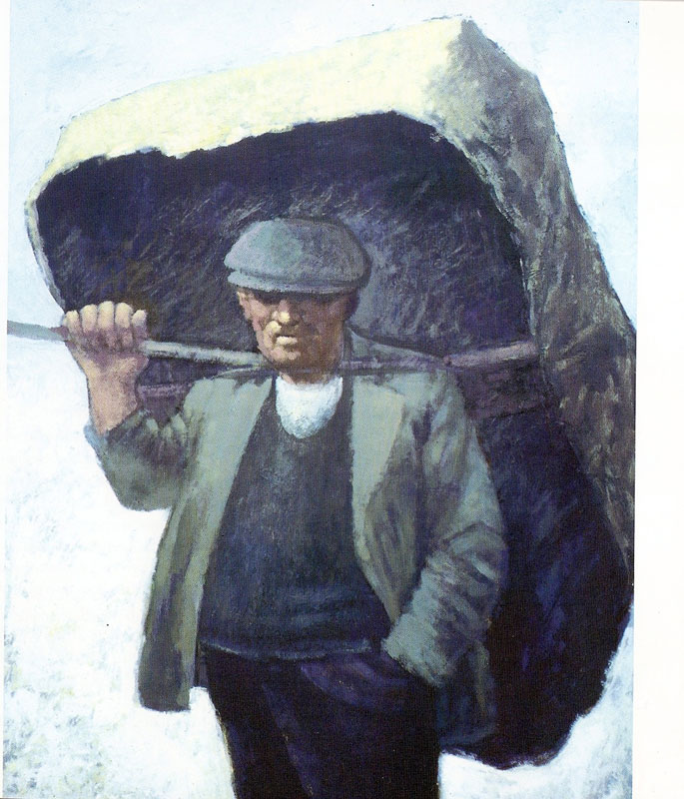
Used with kind permission of Aneurin Jones
A series of interactive lessons and instructions for teachers to create a art project:
Years 5 a 6
Lesson 2
Workers and the workhouse during Victorian Times
Next page
Notes:
1

Slide 2
Create a mind map or a series of quick sketches.
Task: Experiment with different methods of recording ideas. Show your thought processes when looking at a theme within art.
When creating a mind map or a series of quick sketches you are creating a bank of ideas that gather all the information that you have learnt so far. You will also record your ideas in a visual way.
Your teacher is looking for evidence of the information that you have researched and recorded about life in a Victorian workhouse by creating a mind map or a series of quick sketches.
Previous page
Next Page

Slide 3
You will develop these skills:
Thinking
Sketching
Images bent forwards – pose showing frame of the worker.
Colours and tones used by the artist that I have studied.
Dark colour showing sadness and suffering.
Life in the workhouses.
Mind Map -
Victorian Workers
Mood of the artists work that I have studied.
Here are some ideas that you could include in your mind map.
Previous page
Next page

Slide 4
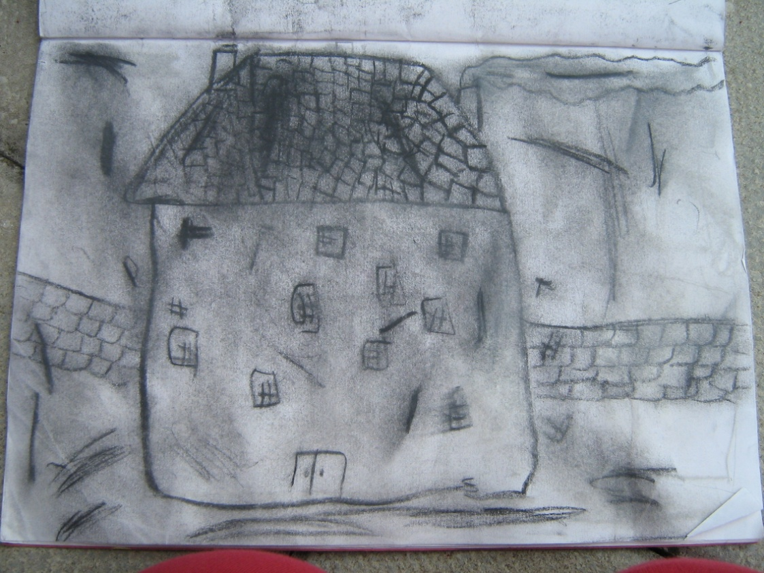
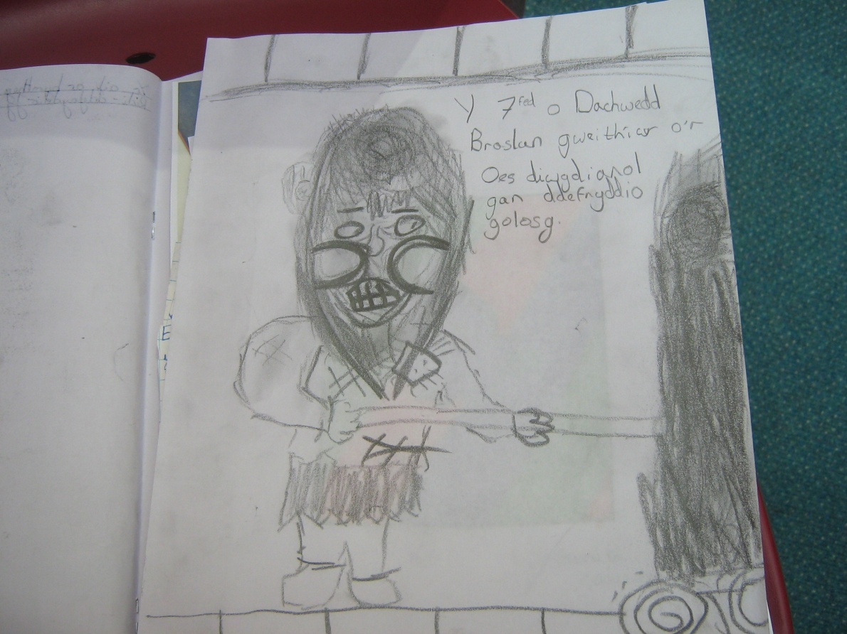
Mediums that you could use:
Sketching books
Felt pens
Soft sketching pencils
Crayons or charcoal.
Examples of quick sketches.
Previous page

